Slide 1
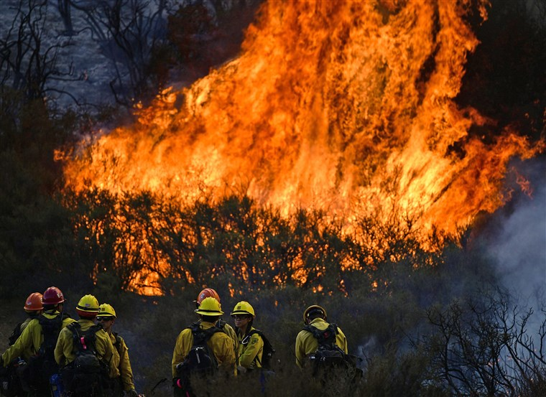
Forest Fire Prediction
By : K Rutva(160118733187)
K Tina(160118733086)

Slide 2
Introduction
The most common hazard in forests is forests fire. They pose a threat not only to the forest wealth but also to the entire regime to fauna and flora seriously disturbing the bio-diversity and the ecology and environment of a region. During summer, when there is no rain for months, the forests become littered with dry senescent leaves and twinges, which could burst into flames ignited by the slightest spark. ? Forest fire causes imbalances in nature and endangers biodiversity by reducing faunal and floral wealth. Traditional methods of fire prevention are not proving effective and it is now essential to raise public awareness on the matter, particularly among those people who live close to or in forested areas
CAUSES OF FOREST FIRE: Causes of forest fires can be divided into two broad categories: environmental (which are beyond control) and human related (which are controllable). Many forest fires start from natural causes such as lightning which set trees on fire. However, rain extinguishes such fires without causing much damage. High atmospheric temperatures and dryness (low humidity) offer favourable circumstances for a fire to start.

Slide 3
Problem statement
The inability to accurately predict fire behaviour conditions and understand public information needs can lead to inefficient use of resources to prevent, suppress and control wild fires as well as prevent the use of prescribed fire as an efficient land management tool. Large forest fire impacts are not fully understood and information is needed to address restoration following these types of fire.

Slide 4
CAUSES FOR FOREST FIRES:
Natural and human caused . There are three elements that are required for a forest fire to burn which are heat oxygen and fuel and these are so-called the fire triangle .
Generally the fire spreads in the direction of he most abundant supply of these elements.
But many other factors such as the area , FFMC , DC , ISI , temperature , wind speed and direction , rain conditions are the required inputs for the prediction of forest fires so that proper prevention measures can be taken .
Natural and human caused .

Slide 5
TYPES OF FOREST FIRES:
Surface fires : They occur in forest on the surface up to 1.3 meters high.
Ground fires: They occur on ground below the leaves .
Crown fires: They are the most dangerous fires that spread fast they occur on top of he trees . They are most destructive.

Slide 6
HUMAN CAUSED FIRES:
Smoking near vegetation
Petroleum products used in logging and hunting equipment .
Campfires that are not well monitored .
Electric faults from the nearby electrical plants
During hunting the use of bullets which can cause fire hazards .

Slide 7
NATURALLY CAUSED FIRES:
Mainly caused in rough terrains which is difficult for personnel reach on time .
Volcanic activities
Spontaneous combustion of dry leaves and vegetation can be responsible for fire outbreaks .
Lightening

Slide 8
PREVENTION:
Can be prevented by using machine learning by estimating the conditions .
By helping people evacuate the region before the accident occurs .
by taking the necessary precautions .

Slide 9
ELEMENTS REQUIRED FOR PREDICTIONS:
X-Coordinate
Y-Coordinate
Month
Day
DMC
DC
ISI
TEMPERATURE
WIND
RAIN
RH(relative humidity)

Slide 10
PREDICTION-AREA BURNT:
Area burnt in the forest is predicted in HA(10000 sq m)
The attributes of FWI system(ISI , DMC ,DC ,Rain ,Wind...etc) play a vital role in predicting how vulnerable a region is to wildfire.
Furthermore , an ML model helps in calculating and predicting the intensity, direction of flow and damages that a forest fire might cause.

Slide 11
Area :- The coordinates and the location so that estimation is easier.
DC :-The Drought Code (DC) is a numeric rating of the average moisture content of deep, compact organic layers. This code is a useful indicator of seasonal drought effects on forest fuels and the amount of smoldering in deep duff layers and large logs.
RH :- Relative Humidity is the moisture content in air and is an important factor to calculate air burnt.

Slide 12
The Initial Spread Index (ISI) is a numeric rating of the expected rate of fire spread. It combines the effects of wind and the FFMC on rate of spread without the influence of variable quantities of fuel.
Temperature :- The temperature in that region as the rate of the fire spread can be estimated .
Wind :- The direction of the wind and the speed .
Rain Probability :- The probability of rain .

Slide 13
DATA COLLECTION:
We referred PDFs, and some other sources on the internet. We need a real time data for preparing the model. Forest fire data has been collected from Github .
The dataset is available in the form of csv with 518entries of data of 11 attributes (x , y , month , day , RH , DC , ISI , temp , wind , rain ,area)
In order to read and use this data, as well as implement the Linear Regression, the language python was used and was done in the IBM CLOUD environment.

Slide 14
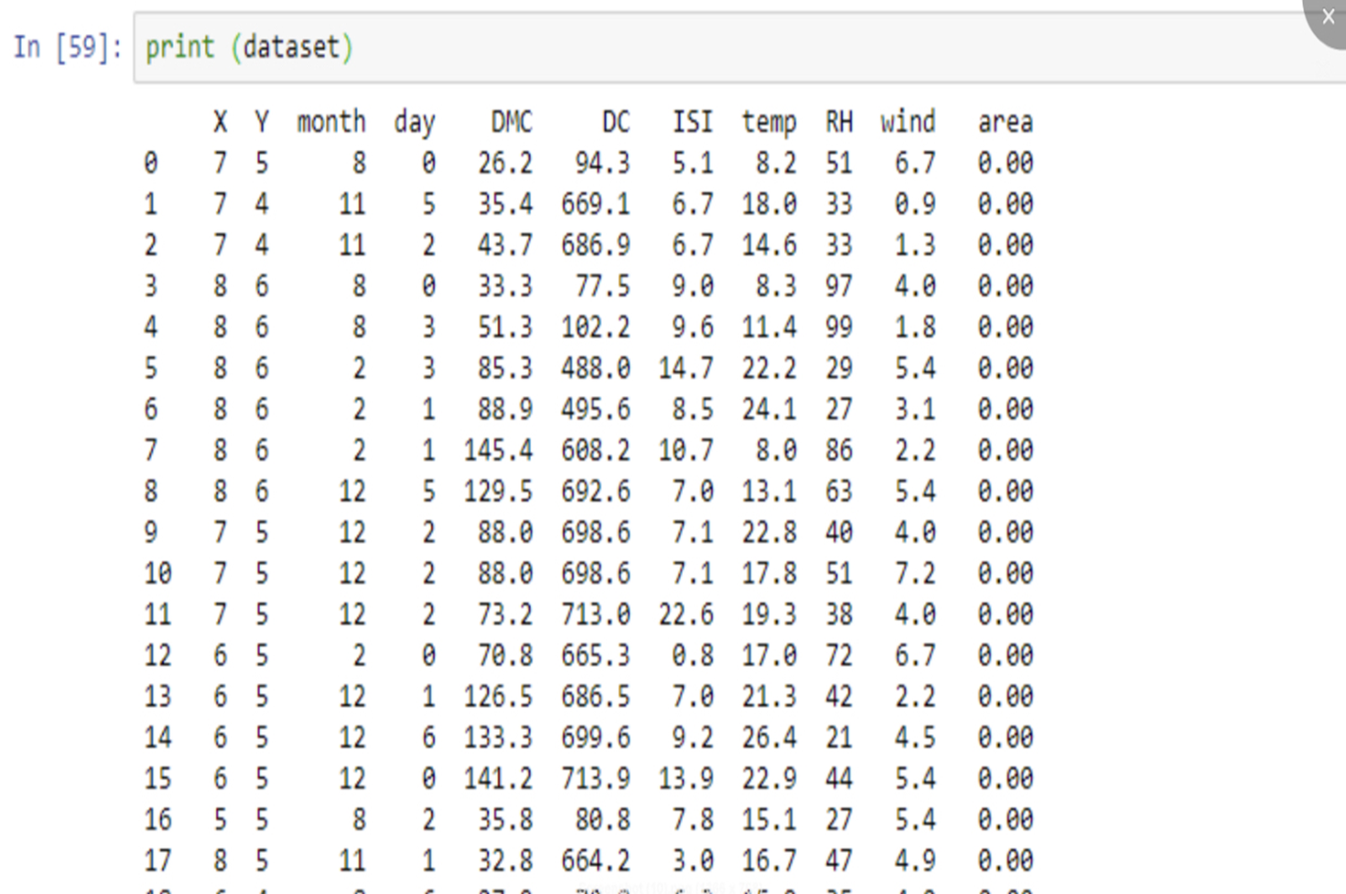

Slide 15
METHOLOGY
SVR | 55.3444
MULTI LINEAR REGRESSION | 70.9222
LINEAR REGRESSION | 71.35

Slide 16
Collection of Data
CODE
IMPLEMENTATION
DEPLOY
NODE-RED
HTML PAGE

Slide 17
Technologies Used :-
Machine Learning
Node-RED
IBM Cloud
Python for programming
GUI

Slide 18
FINDINGS AND SUGGESTIONS:
Be informed
Take precautions
Protect yourself from smoke

Slide 19
CONCLUSION:
Forest fire is multi –sector issues
Forest fire is a national problem , however , limited data inhibit its management and most of the information is based on opinion.
for fire concern
A national campaign on forest fire management is needed
Thus we built a forest fire model using linear regression method/algorithm and got 71.35% accuracy.

Slide 20
REFERENCES:
https://www.sciencedirect.com/topics/earth-and-planetary-sciences/forest-fire
http://vikaspedia.in/energy/environment/know-your-environment/forest-fires
https://github.com/topics/forest-fire
https://www.urgencequebec.gouv.qc.ca/En/situation-urgence/Pages/Incendie-de-foret.aspx
http://www.indiaenvironmentportal.org.in/files/file/Forest-Fire-Prevention-Management.pdf

Slide 21
Thanks!
Any questions?

